Slide 1
Student Supports zooming to success
Clark College Board of Trustees
May 27, 2020

Slide 2
Our Collective Approach
Students at the center of our Work – thankful for leaders, ambassadors, employees
Accessible remote services and programs
Equity, collaboration, and innovation to support access and achievement
Technology (e.g., Zoom, Google Voice, email, Skype, Teams, etc.)
Best practices – personalized and proactive supports
Relationships with students, college, and community partners
Compliance with state and federal regulations
Stabilize and optimize ctcLink
Make difficult choices, protect student and employees, address unintended consequences
Trust and support our employees

Slide 3
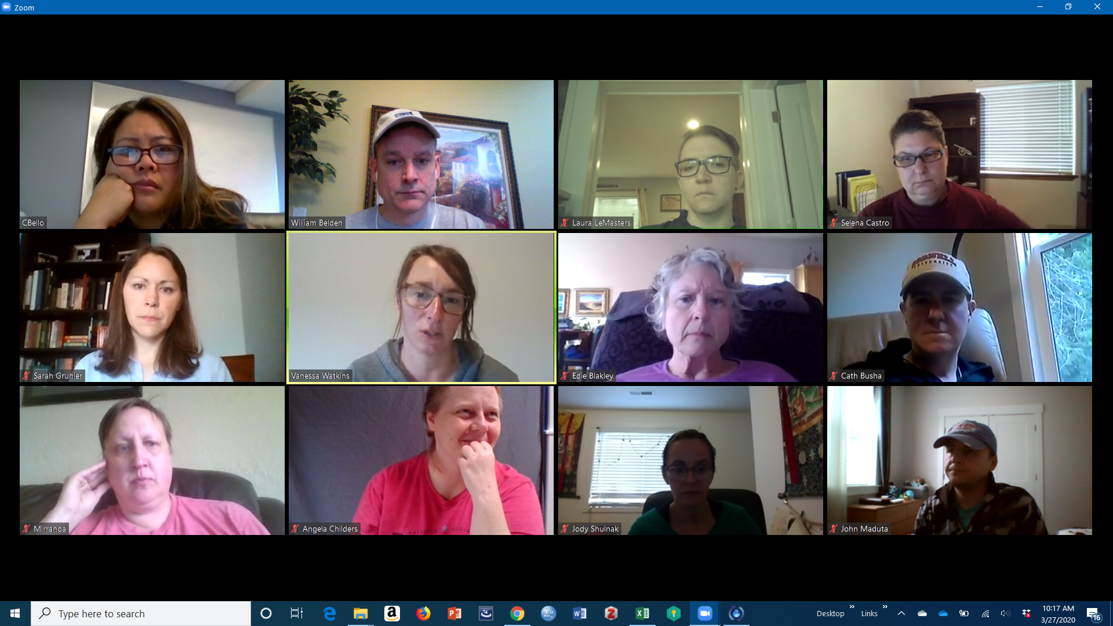
Employee Engagement and Resiliency
Pride in our accomplishments
Strengthen partnerships
Engagement of students and student employees
Weekly all staff meetings
Professional development opportunities – college and national
Increased team meetings – responsive to rapidly changing environment
Employee Assistance Program

Slide 4
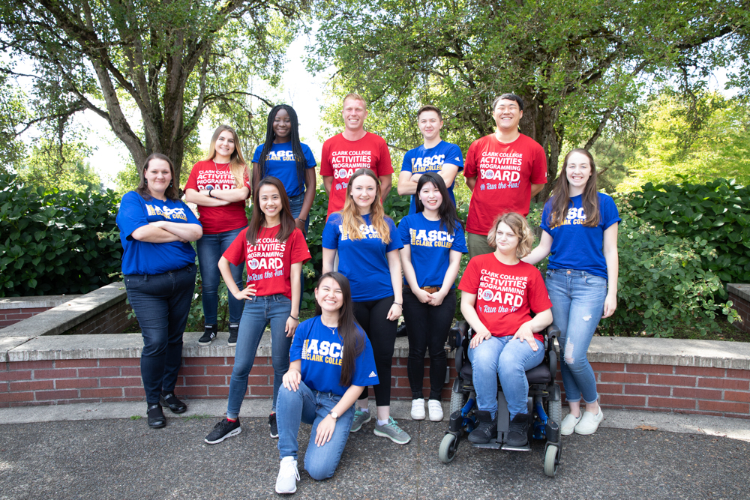
Student Engagement
Weekly communications/Virtual Penguin Digest/FAQs
Student open forums
Phone calling campaigns: Wellness check, Canvas log in, Reminders
Online student activities and ASCC events
Welcome back video
Counseling & Health supports -weekly wellness resources
Increased financial supports

Slide 5

Innovative Services and Resources
Penguin Pantry food resources – monthly food boxes
Converted to online Career Fair, Transfer Fair, and Orientation
Tele-counseling and health services
Resource of the Week – instruction/student supports
Advising and Career new models of student engagement
Financial Aid – early disbursement, professional judgement
Disability Support Services – accessible technology and instructional supports
Expanded financial supports – emergency grants – universal application – partnership between WES, Financial Wellness, Financial Aid, and Veterans
Zoom rooms for additional just-in-time student support – Admissions, Advising, Career, Enrollment Services, and Veterans

Slide 6
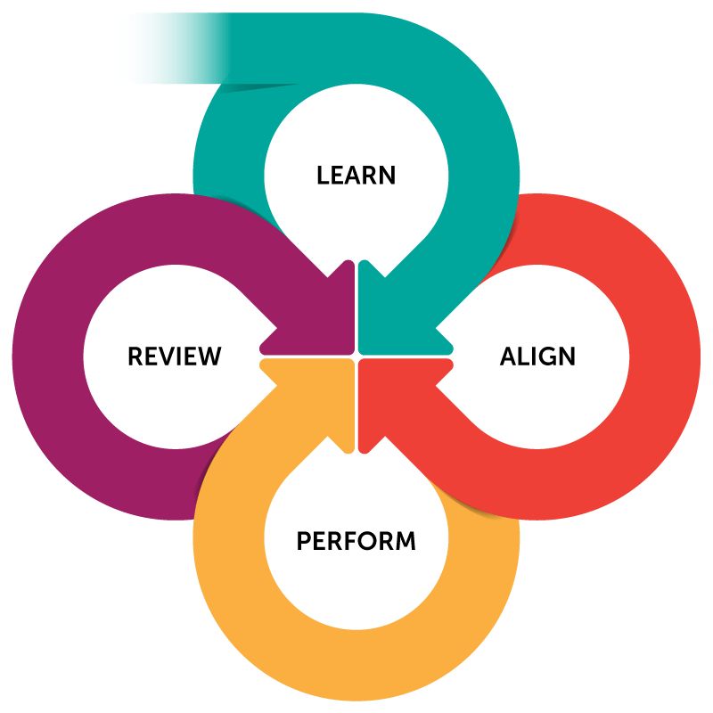
Compliance and Collaboration
Compliance
FERPA guidelines to support remote learning
Add/drop processes/deadlines modified to support changes in learning environment
Pass/No Pass guidance to support student decision making
Tuition deadlines and payment holds
Modification of enrollment calendar
International Student enrollment online/home country
Student conduct and expectations in online only environment
SBCTC Resources
CARES Funding
Veteran student funding
Athletic programs
Direct Admissions Initiative
Running Start summer enrollment options
Commissions and Councils

Slide 7

Ensuring Accessible Technology
Voicemail to email
Zoom chat rooms
Signal Vine texting tool
Remote upload of documents
Electronic RS Enrollment Verification Form
Increased availability of electronic forms
Assessment program – remote proctoring services
Continued optimization of PeopleSoft tools to improve systems

Slide 8

Challenge – Innovate - Repeat
Transformation is difficult under the best of circumstances
What was once unthinkable is our new reality
Teamwork makes the dream work
Focus on making it work, perfection comes later
Compassion goes a long way – a very long way
Our employees are amazing

Slide 9

Questions?

